Slide 1
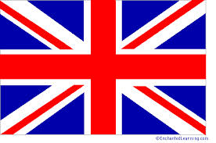
The British Empire

Slide 2
The British Empire
The British Empire was made up of the colonies, protectorates, mandates and other territories ruled or administered by the United Kingdom.
The independence of the Thirteen Colonies in North America in 1783 after the American War of Independence caused Britain to lose some of its oldest and most populous colonies.
British attention soon turned towards Asia, Africa, and the Pacific.
By 1922 the British Empire had power over about 458 million people, one-fifth of the world's population at the time.[
The empire covered more than 33,700,000 km, almost a quarter of the Earth's total land area.
Although the people living in the British colonies were British citizens, they were often times viewed by the English as inferior, second-class citizens (lots of discrimination).
In the Second World War, Britain's colonies in South-East Asia were occupied by Japan. Despite the eventual victory of Britain and its allies, this damaged British prestige and accelerated the decline of the empire.
British India, Britain's most valuable and populous possession, achieved independence two years after the end of the war.

Slide 3
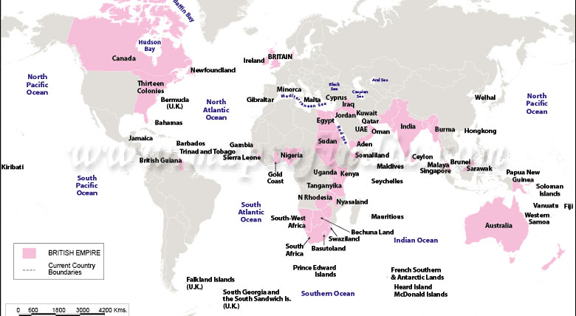
All Countries *Part of the British Empire at some point in history

Slide 4
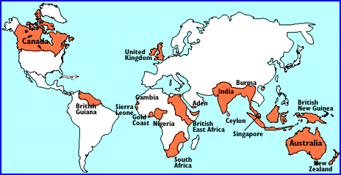
The British Empire Time of “Mr. Know All”

Slide 5
List of Countries
Afghanistan
Antigua and Barbuda
Australia
Bahamas
Bahrain
Barbados
Belize
Botswana
Brunei
Canada
Cyprus
Dominica
Egypt
Fiji
The Gambia
Ghana
Grenada
Guyana
India
Iraq
Ireland
Jamaica
Jordan
Kenya
Kiribati
Kuwait
Lesotho
Malawi
Malaysia
Maldives
Malta
Mauritius
Myanmar
Nauru
New Zealand
Nigeria
Pakistan
Qatar
Saint Lucia
Seychelles
Sierra Leone
Solomon Islands
South Africa
Sri Lanka
Sudan
Swaziland
Tanzania
Trinidad and Tobago
Tuvalu
Uganda
United Arab Emirates
United States
Vanuatu
Yemen
Zambia
Zimbabwe

