Slide 1
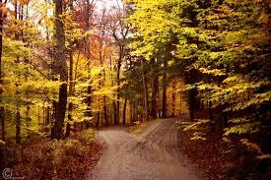
The Road not Taken/ Robert Frost
10th grade 5 points

Slide 2
Stanza #1
Two roads diverged in a yellow wood,
And sorry I could not travel both
And be one traveler, long I stood
And looked down one as far as I could
To where it bent in the undergrowth;
A traveler reaches a split in the road.
He must decide which road to take and he knows he cannot travel both.
He looks down one as far as he can until he cannot see any further (because of the undergrowth)
Yellow Wood = falling leaves/Fall

Slide 3
Stanza #2
Then took the other, as just as fair,
And having perhaps the better claim,
Because it was grassy and wanted wear;
Though as for that the passing there
Had worn them really about the same,
He then looks down the other road.
It looks grassier as though it has not been walked on before. It was appealing to him. (“wants wear”)

Slide 4
Stanza #3
And both that morning equally lay
In leaves no step had trodden black.
Oh, I kept the first for another day
Yet knowing how way leads on to way,
I doubted if I should ever come back.
The speaker chooses the second road (the grassy & risky road).
He reasons that he can always come back and try the first.
But, he knows in his heart that he never really will because one road always leads to the next.

Slide 5
Stanza #4
I shall be telling this with a sigh
Somewhere ages and ages hence:
Two roads diverged in a wood, and I—
I took the one less traveled by,
And that has made all the difference.
The speaker believes that as an old man he will look back at this decision with a “sigh”
He knows that his decision will have impacted his life. It will have made “All the difference…”

