Slide 1
Symbolism
“As I Grew Older”

Slide 2
Symbolism
A symbol is a word or objects that stands for another word or object. The object or word can be seen with the eye or not visible. What is the dove a symbol of?
A dove stands for peace. The dove can be seen and peace cannot.

Slide 3
Sun/Light
Sun/Light: Represents hope for the future.
As a child the speaker only sees light because his future is bright and he has dreams. This sun is slowly diminished by the wall once he experiences racism.

Slide 4
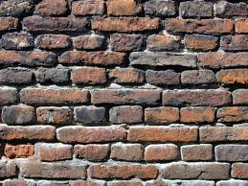
The Wall
The Wall: Represents obstacles.
In the poem the obstacle is the racism that the speaker encounters because he is black.

Slide 5
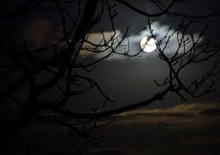
Darkness
Darkness: Represents despair and hopelessness.
As the speaker experiences racism the light is replaced by darkness because he no longer has hope for the future.

Slide 6
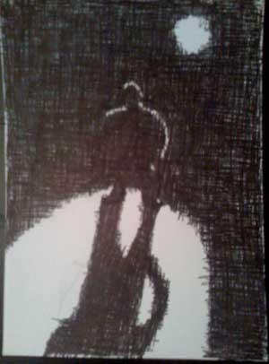
The Shadow
The Shadow: Represents defeat.
The speaker lies down in
the shadow when he has given
up all hope of achieving his
dreams.

Slide 7
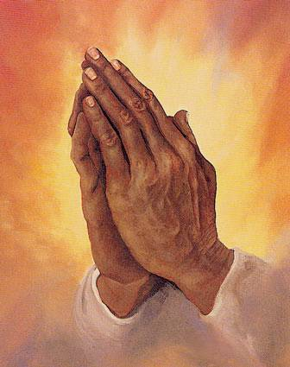
Black Hands
Black Hands: Represents the tool a person uses to overcome their obstacles or fight against them.
The speaker uses creativity and writing to overcome racism. Those are his chosen tools.

