Slide 1
The Road Not Taken
Metaphors & Symbolism

Slide 2
Metaphor - a type of comparison in which one thing is described as if it were something else.
What is the general metaphor in this poem?
The process of making a decision is compared to making the choice of which road to take.
In the poem the speakers decision regarding which road to take is a metaphor for making choices in life. Just like the speaker must decide which road to take, each person must make a decision about which choice to make in life. The author uses symbols such as the fork, the roads, and the underbrush to create this metaphor.

Slide 3
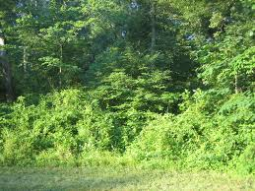
Symbolism- A symbol is a word or objects that stands for another word or object.
Yellow wood=
Undergrowth=
Fork in the road=
A road=
Symbol for life
Symbol for the unknown, the unforeseeable future
Dilemma
A Choice

