Slide 1
HOTS Review - The Wave

Slide 2
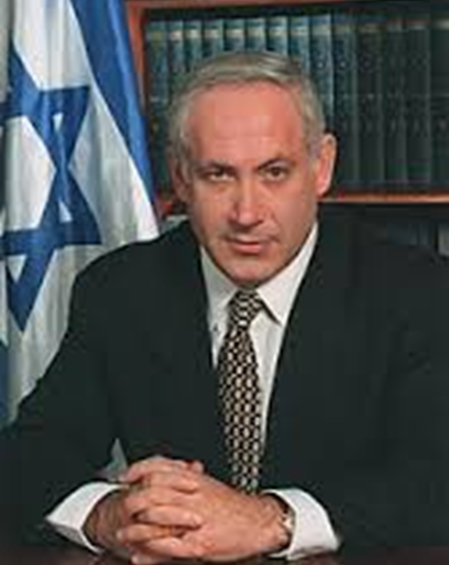
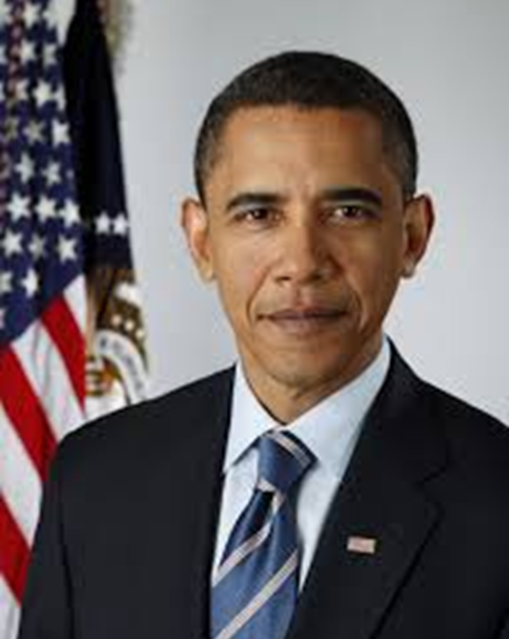
How are they similar? Different?

Slide 3
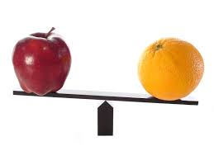
Comparing & Contrasting
How are two things different?
How are two things the same?
You must have an example for each item you are comparing.
Key Vocabulary: alike, similar, different, on the one hand, on the other hand, in contrast to

Slide 4
Sample Question: How do David and Laurie view the Wave differently?
On the one hand, Laurie views The Wave as dangerous.
Anonymous letter
Student getting beat up
The salute at the game.
On the other hand, David sees The Wave in a positive way.
There are no more cliques.
He can use it to help the football team that never wins a game.
There is no more competition and everyone is included (even people like Robert)

Slide 5
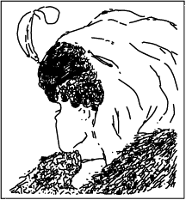
Is the woman in this picture young or old?

Slide 6
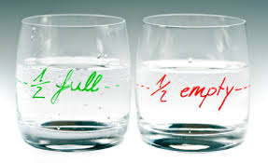
Distinguishing Different Perspectives
Explaining how things are viewed
differently by different people or
at different parts of a literary piece.
You must have TWO perspectives and
TWO examples (one for each perspective)
Key Vocabulary: point of view, view, perspective, sees, outlook

Slide 7
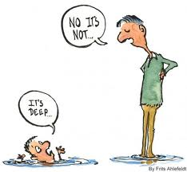
Types of Questions
Usually used when you are asked for
2 character’s:
views
opinions
thoughts
feelings
approaches
perspectives

Slide 8
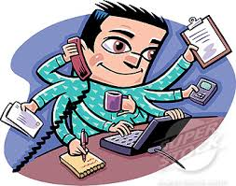
Sample Question: How do Mr. Owens and Ben each view The Wave.
Both men are free thinkers and non- conventional but they view the Wave from
different perspectives.
Mr. Ross has the perspective of an educator. His goal is to teach the students. In this
case he wants to teach them about why the Germans went along with the nazis.
Mr. Owen has a broader perspective. He sees the
administrative implications (parents, counselors, media,
ministry), is accountable for anything that goes wrong and
sees the psychological implications.

Slide 9
Other Differing Perspective in The Wave
Christy & Ben
Laurie & David
Laurie & Amy
Robert & Laurie
Mr. Saunders and Mrs. Saunders.
David while in the Wave & after leaving ...

Slide 10
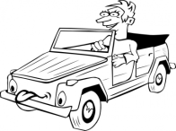
What is Jack’s motive for this behavior?
Jack, a middle-aged man, is driving down a dark, deserted country road. Suddenly he sees in his rear view mirror the colored lights of a police car and hears the siren. He drives faster. He keeps looking worriedly in the mirrors to see if the police car is still there. He looks at his wedding ring. He begins to sweat.

Slide 11
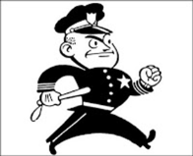
Now… what is the real motive?
The policeman comes up to his window and says "Do you know you were speeding? Didn't you see me? Why didn't you stop?"
The man, panicking answers: "Last week my wife left me for a policeman and I was sure you were trying to give her back."

Slide 12
Uncovering Motives
Uncovering the motive
behind a characters behavior.
You must have examples from
the text to support your explanation.
Key Vocabulary: intention, purpose, goal,
reason, motivation, drive

Slide 13
Sample Question: What is Ben’s reason for introducing The Wave?
Ben’s motivation behind introducing The Wave was to show the students why the German’s went along with the Nazi agenda.
He was unable to answer the question through research.
His intention was to give the students a taste of authority by presenting the three rules (saying his name, standing next to the chair and bringing pen and paper). He believed this would demonstrate his point.

Slide 14
What caused these people to be in this boat?

Slide 15
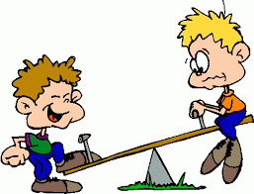
Cause & Effect
Finding the reason for OR the result of an action.
Usually either the cause or the effect
can be found in the question.
You must have a specific example supporting
both the cause & effect.
Key Vocabulary: as a result, leads to, therefore, consequently, reason, cause

Slide 16
Sample Question: Why does the principal want to speak to Ben for a second time?
The principal wants to speak to Ben for a second time as a result of new and negative developments in The Wave.
Parents have started to complain.
Additional students have come forward complaining of abuse from Wave members.
School counselors have started interviewing the students to get more information about what was going on within the movement.

Slide 17
Jimmy Pickens
Police found Jimmy Pickens a block away from a house that had just been burglarized.
He was walking down an alley with a
ladder in his hands.
He said he did not do the burglary.
Nobody witnessed the crime.
Did he do it?

Slide 18
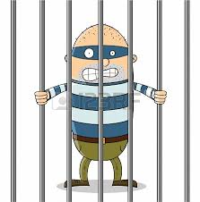
The Judge Found Him Guilty!
Jimmy had shown a pattern of behavior.
In each of his two past crimes, he had:
Used a ladder
Climbed into the upstairs window

Slide 19
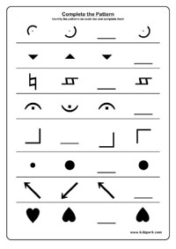
Explaining Patterns of Behavior
Identifying and explaining patterns in a story or character.
You must have two examples supporting
the pattern.
Key Vocabulary: pattern, repeat, repetition,
significance, similar, always, many times, tendency

Slide 20
Sample Question: Why is Christy concerned about Ben’s excitement about the student’s interest in The Wave?
Ben has a pattern of behavior of becoming overzealous about topics he becomes interested in. Christy believes that this tendency will repeat itself when it comes to The Wave. For example…
He became obsessed with Native Americans and invited one to dinner, starting wearing moccasins and slept in a tippi.
Ben became obsessed with Bridge and starting reading tons of books in order to learn how to play better. In addition, he started to compete in many tournaments.

Slide 21
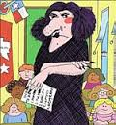
Do you think this teacher likes children?

Slide 22
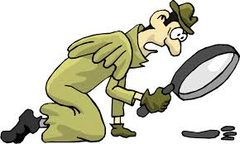
Making Inferences
Reading between the lines to
understand information that is
not specifically stated.
You must have specific examples
to support your inference.
Key Vocabulary: infer, deduce, conclude, read between the lines, assume

Slide 23
Sample Question: Why was the Jewish kid beat up?
We are not told why the Jewish kid was beat up. However, we can assume that it was because he was Jewish for a couple of reasons.
First, there was only one kid beat up for not joining The Wave and he happened to be Jewish.
Second, the attackers called the kid a “dirty Jew”.

Slide 24
Remember!!!!
Read the question carefully to determine which HOTS to use. Choose the HOTS before starting to write the answer.
For every single HOTS question you MUST have: HOTS Vocabulary + Examples from the poem/story/novel
Read your answer once you are done to see if additional examples and vocabulary can be added.

