Slide 1
A Summer's Reading – A sample test -
A guided video lesson

Slide 2
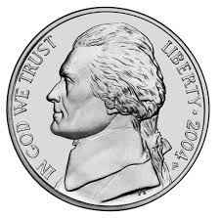
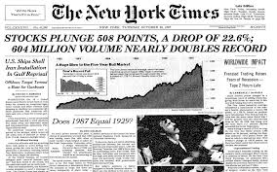
LOTS
Name ONE way Mr. Cattanzara was different from the other people in the neighborhood.
- He took a real interest , asking questions
- he was intelligent - read the NY Times
- he gave kids a nickel to buy lemon ice

Slide 3
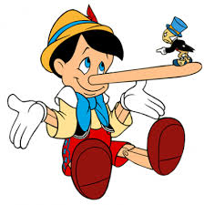
Analysis
*Remember you need to make a statement and then justify it with a couple of examples
Mr. Cattanzara has an unusual way of educating George. Why do you think he chose to reinforce the lie that George told?

Slide 4
Analysis- answer:
Mr. Cattanzara indeed has an unconventional way of educating George throughout the story. Probably sensing that George’s saying that he is reading 100 books is an exaggeration, he spreads the rumor around the neighborhood, and later on even that he has finished reading them. He probably wished to make George feel so uncomfortable thus making him get out and do something active, so that he’ll feel the praise and pride he’s receiving is well- deserved and earned. This method indeed proved effective as George ultimately realizes that the most important kind of respect is self- respect.

Slide 5
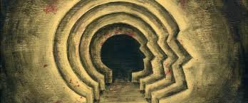
HOTS - Compare and Contrast
Describe the development of George’s psychological inner change.

Slide 6
HOTS- answer
In the beginning George is immature and child- like. He never assumes responsibity for his past failures to hold a steady job for instance (he simply tired of them, nor to graduate (he felt the teachers didn’t respect him). He has an excuse for everything and even gets an allowance from his sister, much like a child. George finally is confronted by his own lies upon coming across Mr. Cattanzara face to face, and ultimately upon hearing that everyone thinks he actually finished reading the books. He goes into seclusion and contemplates his choices and stays locked up in his room for almost a week. Finally, he bursts into the library one day in the fall and sits down to read, realizing the future has to be realized now by actions and not by daydreaming like before. George’s psychological development can be likened to the development of a butterfly. Initaially he’s like a caterppilar young and immature, then he goes into seclusion to grow up and mature within his coccoon, and finally he spreads his wings as a butterfly, a grown young man ready to face the world.

Slide 7
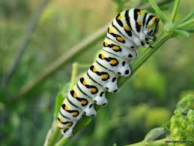
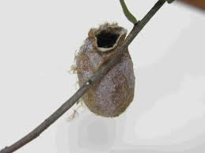
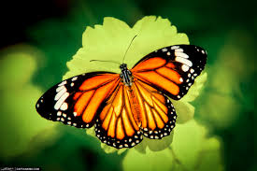

Slide 8
HOTS – Cause and effect
What is the meaning of Mr. Cattanzara’s words: “George, don’t do what I did”?
In your answer use the thinking skill of cause and effect.

Slide 9
Bridging text and context:
“Children have to be educated, but they have also to be left to educate themselves.”/Ernest Dimnet
How does this quote connect with “A Summer’s Reading” and Malamud’s development of the theme of education in it?

Slide 10
Bridging text and context - answer
There is no doubt that children need to be formally schooled in order to become
educated, cultural and knowledgeable members of society. But, is formal
schooling the most important one? Is it the only one? These questions are raised in
the above quote.
Indeed the theme of reading, knowledge and education are thoroughly developed by Malamud in "A Summer's Reading". George dropped out of school and had not completed his formal education. This embarrasses him when going to job interviews. He reads only simple picture magazines and sometimes simple popular newspapers for the masses. Mr. Cattanzara is also not formally educated but is self-taught. He is active and takes an interest in worldly occurrences. He reads the "New York Times" from front to back. George lies about reading the 100 books because he wants to gain the respect of Mr. Cattanzara, the neighborhood and his family. It is only upon learning and realizing that the only respect that matters is self-respect that he goes to the library to read.
Indeed George was left to educate himself. Mr. Cattanzara only put a mirror to his face and made him feel so uncomfortable that he secluded himself, thought hard about what he did and came to his realization of the proper thing to be done.

